Slide 1
Examination Timetabling Automation using Hybrid Meta-heuristics
Miguel de Brito e Nunes
Artur Jorge Ferreira
Nuno Miguel da Costa de Sousa Leite

Slide 2
Summary
The Timetabling Problem
Existing Approaches
ITC2007 Examination Timetabling Problem
System Architecture
Loader and Solution Initialization
Proposed Approach: Local Search
Experimental Results
Conclusions
Future Work

Slide 3
Goals of this project
First phase:
Study of techniques and solutions for the examination timetabling problem
Second phase:
Generation of timetables according to the ITC 2007 (International Timetable Competition) - examination timetabling track
Timetable Validator
Results comparison with the ITC 2007 – examination timetabling track competitors and more up-to-date approaches

Slide 4
The Timetabling Problem (1/2)
Examination Timetabling
Course Timetabling
School Timetabling
Problem constraints:
Hard constraints – mandatory rules which must be followed, in order to obtain a feasible/valid solution
Soft constraints – non mandatory rules; if followed, the solution is improved; otherwise, it suffers some penalty

Slide 5
The Timetabling Problem (2/2)
Two possible formulations:
Search problem
Optimization problem
Possible types of solutions:
Feasible
Non feasible
Optimal
Sub-optimal

Slide 6
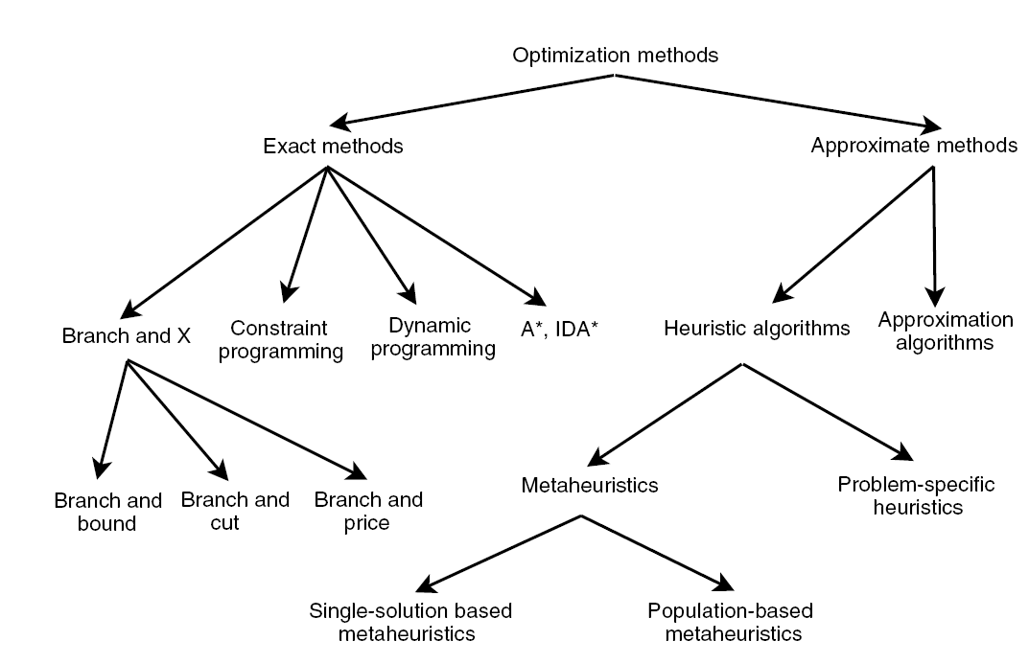
Existing Approaches
Exact Approaches
Approximation Approaches
Heuristics
Graph Coloring Based techniques
Pop Single-solution based meta-heuristics
Population based meta-heuristics

Slide 7
Exact Algorithms
Search the whole space of solutions
It is guaranteed that an optimal solution is found
Inappropriate for relatively large sized problem instances
Algorithms
Branch-and-Bound
Constraint-Programming

Slide 8
Graph Coloring Based Techniques
Problem-specific heuristic
Assign the minimum set of colors to an element type of the graph following certain constraints
Examples of Graph Coloring problems:
Vertex Coloring
Edge Coloring
Timetabling problems can be reduced to a graph coloring problem

Slide 9
Meta-heuristics
General algorithmic frameworks, often nature-inspired, designed to solve complex optimization problems
In timetabling problems it is mostly used to optimize feasible solutions provided by problem-specific heuristics
Sub-types:
Single-Solution Based Meta-heuristics
Population-Based Meta-heuristics
Meta-heuristics for Multiobjective Optimization
Hybrid Meta-heuristics
Parallel Meta-heuristic

Slide 10
ITC2007 Examination timetabling problem (1/4)
12 different datasets
Ranking depends on the distance to feasibility and fitness values
The available execution time limit was set to 225 seconds, as measured by the benchmarking tool

Slide 11
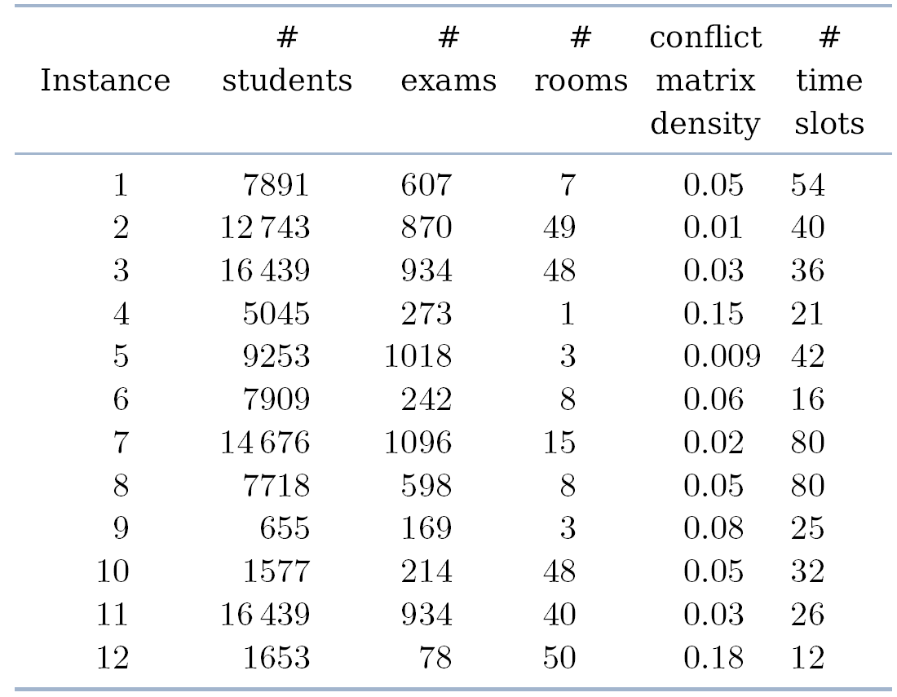
ITC2007 Examination timetabling problem (2/4)
Benchmark data and specifications:

Slide 12
ITC2007 Examination timetabling problem (3/4)
The hard constraints are the following:
No student must be in more than 1 exam at the same time
Room’s capacity must not be exceeded
Exam’s length must not surpass the assigned time slot’s length
Exams hard constraints must be followed (e.g., 1 AFTER 2)
Rooms hard constraints must be followed (e.g., 1 ROOM_EXCLUSIVE)

Slide 13
ITC2007 Examination timetabling problem (4/4)
The soft constraints are the following:
Two exams in a row or in a day
Period spread
Mixed durations
Larger exams constraints
Room penalty
Period penalty

Slide 14
Proposed Solution
Graph Coloring
Simulated Annealing
Hill Climbing
Examination Timetable
ITC 2007 Data
Loader

Slide 15
Proposed Architecture (1/2)
Data Layer
Stores all entities (e.g., Examinations, timeslots
Data Access Layer
Provides repositories to access the stored entities
Business Layer
Provides functionalities to manipulate the repositories
All business classes implement the Singleton pattern
Heuristics Layer
Provides access to the implemented heuristics
Tools Layer
Tools used by the Heuristics Layer and higher layers
Presentation Layer

Slide 16
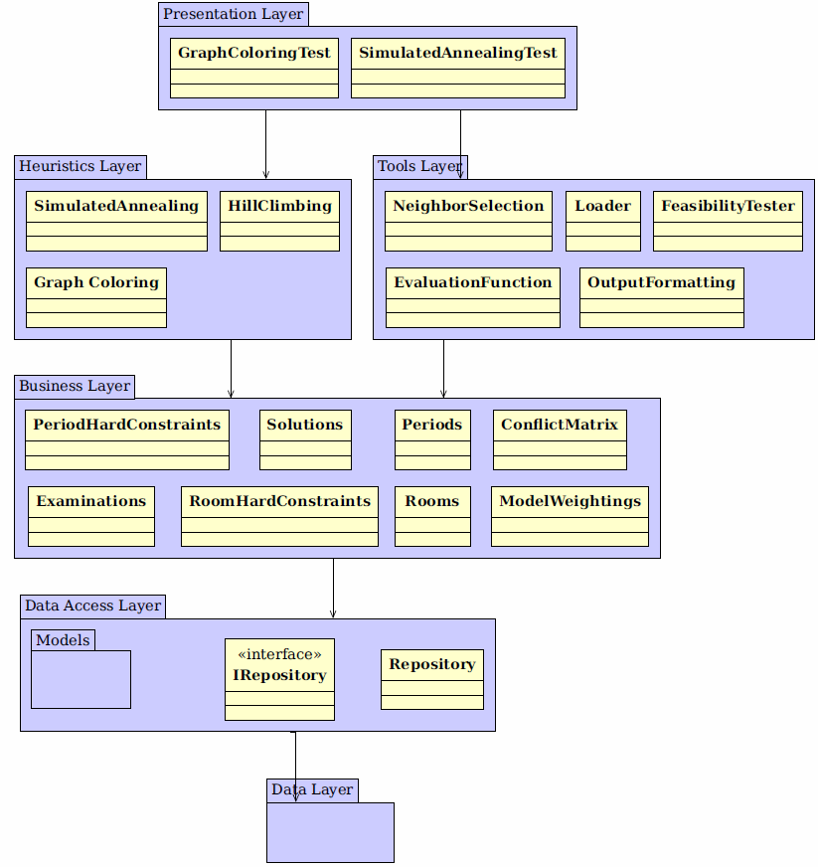
Proposed Architecture (2/2)

Slide 17
Loader
Loads all the information from the dataset
Creates and populates the conflict matrix
Each dataset contains all the information required to create a solution:
Examinations and students’ enrollments
Rooms, their capacities and penalties
Periods and their penalties
Period and room hard constraints (optional)
Soft constraints

Slide 18
Graph Coloring
Generates an initial feasible solution
Largest Degree Ordering method is used
Implementation:
Populates and sort the assignment lists:
Unassigned examinations with room exclusivity hard constraint
Unassigned examinations with after hard constraint
Unassigned examinations with examination coincidence hard constraint
All other unassigned examinations
Examination assignment.
Normal assignment
Forcing assignment

Slide 19
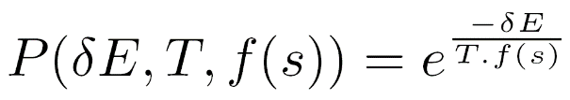

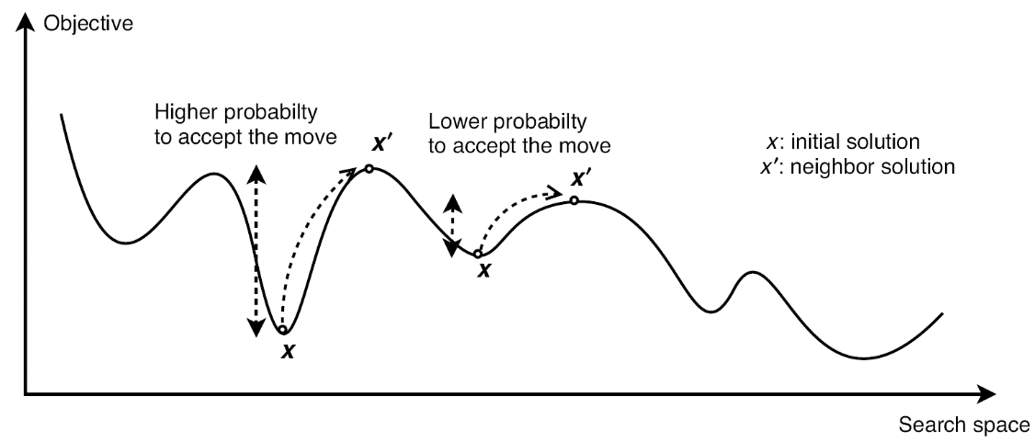
Simulated Annealing (1/2)
Neighbor operators generate neighbor solutions
Neighbor solutions’ acceptance criterion:
Exponential (decreasing) cooling schedule:
Parameters used in this meta-heuristic:
Maximum temperature
Minimum temperature
Number of iterations per temperature value
Temperature decreasing rate

